Slide 1






Professional Practices in Educational Sector

Slide 2


Presented By:
Ayaz Hasan
Ferdeen Bakht
Syed Arsalan
Fast Nuces,Karachi

Slide 3



Agenda
KEY TOPICS DISCUSSED IN THIS PRESENTATION
About School Human Resources Strategy Data Protection Strategy Contract Assignments Descrimination Financial Terms Suggestions

Slide 4

About School
Iqra Huffaz Boys Secondary School prepare students to be successful lifelong learners, armed with the necessary knowledge; religious and worldly, along with skills necessary to succeed at school and at institutions of higher education as well as everyday life and in their future careers. Iqra Huffaz Boys Secondary School strictly follow the Sharia rules and gives complete religious atmosphere to the students.

Slide 5

Questionnaire
How do you manage students' satisfaction with newly hired teachers?
opportunity to provide a demo class . student feedback is considered
major factors that increase employee loyalty?
appreciation and bonuses throughout an individual's career
Human Resources

Slide 6

Questionnaire
For what purposes is the information collected?
to maintain all academic records for each student data related to staff members, schedules, and resource allocation.
how you manage data protection
Personal information is primarily stored in digital formats on secure and password-protected computer systems
Data Protection

Slide 7

Questionnaire
What types of contracts are commonly held
Employee Contract Service Contract Vendor Contract
Who are the parties involved in the contracts
● Employees,Vendors ,Service Providers ,Parents/Guardians:
What notice period is required for termination?
allowing sufficient time for both the employee and the institution to manage the transition effectively.
Contracts

Slide 8
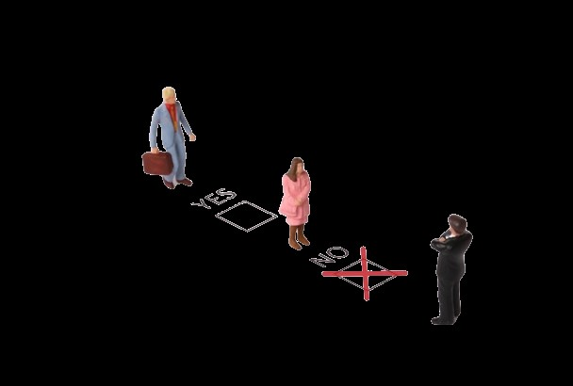
Questionnaire
there is any Discrimination during the hiring process?
Not any direct Discrimination Indirect due to already created rule
What action do you take in case of harassment at the workplace?
● Higher management will investigate the issue Take strict action against proof
Discrimination

Slide 9

Are payment terms, including amounts, timelines, and methods, clearly defined
yes clearly defined with mutual agreement
. Who is responsible for what in the event of failure, damage, or legal action
● second party in case of delay of terms according to the contract from vendor School in case of any delay of terms according to the contract from school
Questionnaire
Financial Terms

Slide 10

Suggestions
Training For Data Privacy
Student Safety Policy
Ready For Professional Era
Regarding Intellectual Rights

Slide 11
THANK YOU!

